Slide 1
FAA DataViz Challenge After-Action Review (AAR)
September 21, 2021
Christopher Burch, MBA, CPPS
Consultant

Slide 2
What is an After Action Review (AAR)?
A tool to capture lessons learned
A dynamic, professional, and candid discussion of an event
NOT a critique or complaint setting or a full-scale evaluation report
Answers 4 major questions:
1. What was supposed to happen?
2. What actually occurred?
3. What went well, and why?
4. What can be improved, and how?

Slide 3
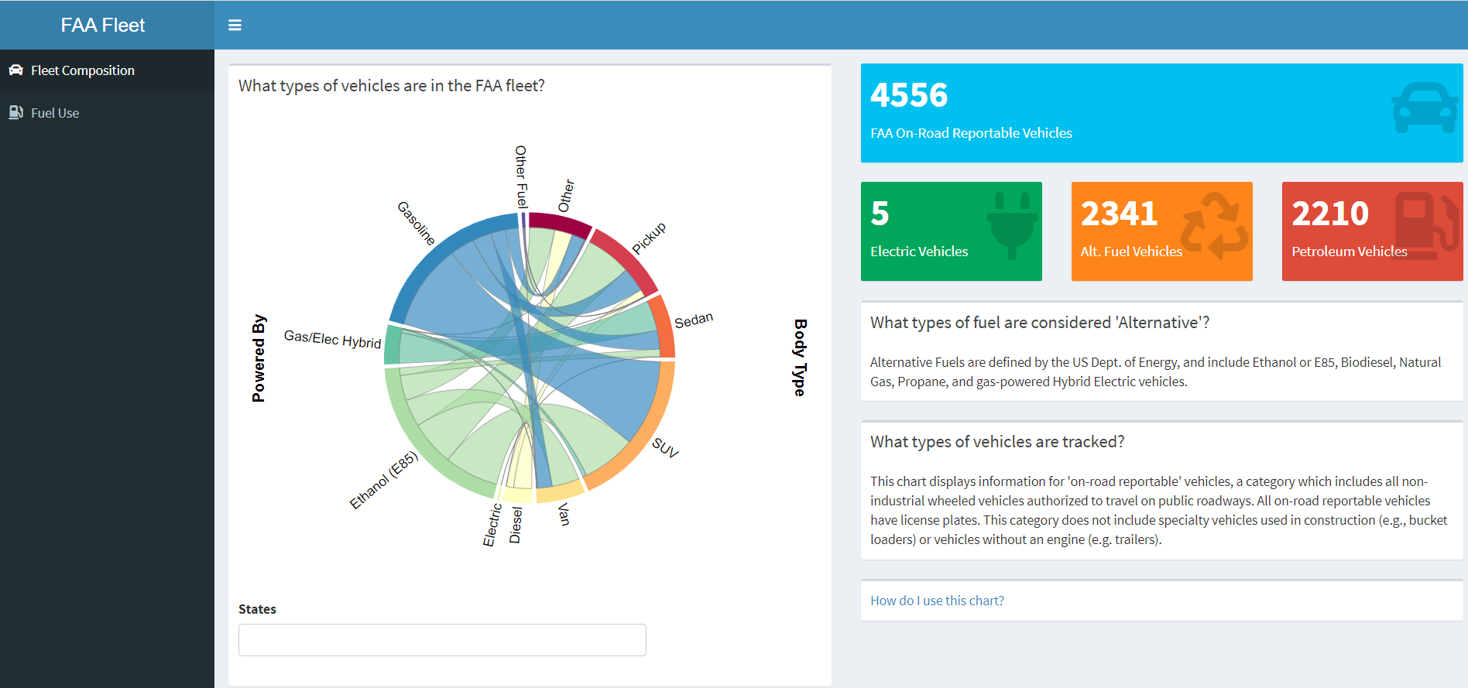
https://cburch.shinyapp.io/Data-Viz-Challenge

Slide 4
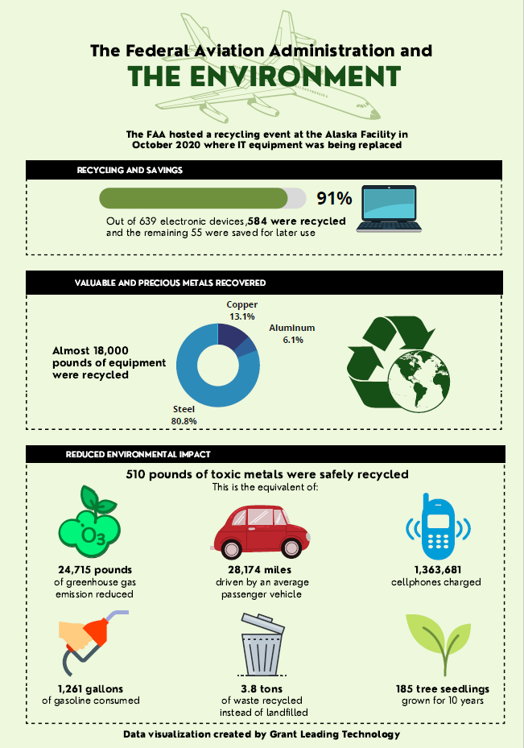

Slide 5
What did we intend to do?
Challenge Objectives (FAA)
Develop a visualization that leverages data from the Administrator’s Fact Book and other related data sets.
Explore the EIM Platform, which provides access to a repository of FAA data and a suite of cloud-based tools dedicate to enabling users to Discover, Access, Explore & Transform, Analyze & Model, and Visualize data.

Slide 6
What did we intend to do? (cont.)
Additional Objectives (GLT)
Show GLT expertise and capabilities
Develop internal practices
?
Notes:
Goals for GLT participation:
Develop internal best practices (Kim)
Determine interests for GLT personnel (Marla)
Internal growth / challenges (Sulvia & Hrishikesh, Sahil)
Brainstorming (Marla)
Learn new things (Kim & Marla)

Slide 7
What actually occurred? Did we accomplish our goals?
Products Produced:
Interactive dashboard
Shiny/javascript
Independent of vendor (MS, etc)
Static graphic
Combination of techniques used
Notes:
Team built the products according to the instructions, but did not consider who the judges were or what they might be expecting; need to fully understand the audience better
Marla: product was built to look cool but was not intuitive for her
Sulvia: product was intuitive for her, but she’s been working on this data for 5+ years and 3+ years with Chris (who built the dashboard) – familiarity/domain needs to be considered
Chris: good that Sulvia and Marla are both on team b/c their different backgrounds help them see the same thing with different contexts

Slide 8
What actually occurred?

Slide 9
What went well, and why?
Notes:
Nick: Team submitted 2 entries – was this a good idea or not?
Marla: might have been better to spend more time on one presentation
Sahil: building two presentations shows GLT’s range
collaboration: team reached outside of the APM-400 property team; team members were focused on solutions and not egos
Made more difficult b/c we don’t know who has what interests/skills
Sahil: GLT has discussed evaluation matrix for skills, would be helpful with cross-team projects
Good communication in team meetings; all were encouraged to contribute; atmosphere was kept constructive

Slide 10
What could be improved, and how?
Admin considerations – regulations, paperwork, etc.
Rushed / last minute
Almost missed admin deadlines for CO notification
Improvements
Can improve with advance planning
Currently implementing advanced planning with the latest competition (Bot Challenge)
Notes:
Kim: we need to keep leadership more informed of progress and allow for more feedback → insert planned feedback/exec briefing sessions in future projects
Marcus: need to define SME and should look at how SMEs are defined in industry
Kim: use performance evals to collect information about skills, interests for future training/groups
- list top 3 skills you think you have
- list top 3 skills you want to learn/improve
Marcus: who reviews / confirms SME status?

Slide 11
What could be improved, and how?
Design / Participation – more voices / perspectives, especially for creative or new ideas
Data Viz team was relatively small
Relatively few meetings
Not a lot of delegation
Improvements
Larger / more diverse team
Reach across GLT to find subject matter experts
Involve GLT team to create subject matter experts
Notes:
Focused on technology, and didn’t focus as much on the story for the interactive dashboard → include non-technical reviews in the formal review / internal eval process
Sahil: if time allows, show product to all GLT members and ask for feedback
Potential A/B testing
Marla: internal focus groups

Slide 12
What could be improved, and how?

Slide 13
Conclusions
Participation in this challenge was beneficial to GLT, even if we don’t win
We need to apply a project management approach to any future challenges of this nature
We need to identify and encourage individual areas of expertise and interest (graphic design, coding, pitching, etc.)
?
Notes:
Sahil: interest in topics might encourage after-hours work on projects, but we should figure out how we want to allocate time for bizdev/projects like this in the future → need formal policy regarding time spent working on external projects
- AAR process should be explored for wider use at GLT/FAA
Collect responses for AAR in real-time, perhaps in PPT comments or directly on page so participants can see the data being collected
Formal v informal processes

Slide 14
Questions / Comments
Notes:
CONCLUSIONS
Participation was a good thing and participation in future contests / one-offs should be encouraged as part of business development
AAR process should be implemented where possible as GLT grows
Focus on audience and consider the story behind a visualization or chart – is this the best way to convey this piece of information?
Diverse teams are important to success and should be intentionally constructed to provide an array of backgrounds, approaches, and familiarity with the subject
Open communication which solicits and considers multiple viewpoints is critical to success
Potential new lines of business / products to be developed from GLT personnel expertise and interests – encourage and develop a formalized process to identify and train interests

